Slide 1
Dynamic Recompilation of Legacy Applications: A Case Study of Prefetching using Dynamic Monitoring
Mauricio Serrano, Jose Castanos, Hubertus Franke
Notes:
Several optimizations in XL core compilers have been exploited for Power7, including VSX/SIMDization support, instruction scheduling, auto-parallelization, and so on. This presentation just cover one of particular optimizations, called advanced memory hierarchy optimizations.
In this milestone, we are going to present performance improvements with memory hierarchy optimizaitons on early power7 machines.
The compiler will demonstrate these improvements through:
Dynamic profiling infrastructure for delinquent load identification
Data prefetch optimization and loop transformations using compiler static analysis and dynamic profiling information
Data reorganization using compiler static analysis and dynamic profiling information

Slide 2
Outline
Overview of the Dynamic Compilation Infrastructure
PFLOATRAN Application
Delinquent Load Optimization
Performance Results
Open Challenges
Notes:
In this presentation, I will first talk about the motivation and project goals, then I will update you the accomplishments we have achieved for MS#7 deliverables.
After we go through the technical details, we will show you the performance improvement on Power7 through memory hierarchy optimizations.
what are the motivation and project goals?
what accomplishments we have achieved, including ….
What is IBM XL compiler release plan, including what we have shipped and what we will ship in XL compiler releases.
Summary
Dynamic performance counter profiling
Delinquent load driven optimizations
Data reorganization extension and enhancement
Data prefetching extension and enhancement

Slide 3
Acknowledgments
IBM Research:
  Mauricio Serrano, Jose Castanos
IBM Toronto:
  Allan Kielstra, Gita Koblents, Yaoqing Gao, Vijay Sundaresan, Kevin Stoodley, Derek Inglis, Patrick Gallop, Chris Donawa
Oak Ridge National Lab:
  Stephen Poole
Notes:
this is a joint work between IBM Toronto software lab and IBM Research lab. Many IBM people from different sites made contributions to this project in different aspects. Particularly People from Toronto compiler group, people from IBM Research.

Slide 4
Combined Static-Dynamic Optimization Infrastructure
Profile
Directed Feedback
profiling information
C, C++, F
Front
End
wcode
High
Level
Optimizer
(TPO)
wcode
Code Gen
(TOBEY)
Traditional
Execution
exec
OpenMP
UPC
CAF
WCode
Driver
CPO
Runtime
wcode
exec
Code Gen
(TR)
Fat binary
Dynamic
Compiler
(TR)
HW events
Notes:
User application is processed by existing XL front-ends into Intermediate Representation (wcode)
High level optimizer (TPO) applies standard static optimizations (including profile directed feedback)
Output of TPO (also in wcode IR) is processed by a new backend that generates binary executable
Relies on code generation by the Testarossa dynamic compiler used in static mode
Generates a fat binary executable that supports dynamic re-compilation and re-linking
Generated application runs in two modes:
Traditionally
No overhead from CPO
Performance almost in par with IBM product compilers
Linked against the Dynamic Optimization Agent
Performs re-compilation and optimization at runtime

Slide 5
CPO Managed Runtime
Loads and launches user application
  Receives as input enhanced executable files
    Binary executable
    Program representation (IR) used generate the binary and compiler metadata
Oversees execution of user codes
  Maintains a Code Cache of binary instructions (from both static and dynamic compilation)
    Also includes mappings of binary code, symbols and constants to the IR (and therefore to source code)
  Monitoring environment
    Permits identification of performance bottlenecks on hot sections of the code
    Supports mapping of hardware events (i.e. cache misses) to binary code and then to internal data structures (i.e. IR)
Triggers dynamic compilation and optimization
  Includes Testarossa (TR) Dynamic compiler as a library
  CPO agent provides to the JIT:
    Stored IR representation of the function
    Relevant runtime information
      Profile values, actual values, specific machine characteristics
  JIT provides new binary sequence for the instruction and compilation metadata
  JIT and managed runtime collaborate on linking the dynamically generated code into the running executable

Slide 6
Architecture of PMU Online Collection
Epoch #
sample request for Epoch #
AIX
Trace
PMU
Server
CPO
Runtime
batch of samples
register PID of application
run application
Hardware sample event
a.out
Power5/6 SIAR-SDAR

Slide 7
PFLOTRAN
Multiphase-multicomponent reactive flow and transport
  Geologic sequestration of CO₂ on saline aquifers
Coupled system
  Mass and energy flow code (PFLOW)
  Reactive transport code (PTRAN)
Modular, object oriented F90
  HDF5 for parallel IO
  PETSc 2.3.3 library (Argonne)
    Parallel solvers and preconditioners
      SNES nonlinear solvers for PFLOW
      KSP linear solver for PTRAN
  Most of the computation time is spent inside PETSc routines
Scalable
  12000 cores with 79% efficiency (strong scaling)
  Domain decomposition

Slide 8
Loop prefetch analysis
PetscErrorCode MatSolve_SeqBAIJ_3_NaturalOrdering(Mat A,Vec bb,Vec xx) {
…
/* forward solve the lower triangular */
for (i = 1; i < n; i++) {
v = aa + 9*ai[i];
vi = aj + ai[i];
nz = diag[i] - ai[i];
idx += 3;
s1 = b[idx]; s2 = b[1+idx]; s3 = b[2+idx];
while (nz--) {
jdx = 3*(*vi++);
x1 = x[jdx];x2 = x[1+jdx];x3 = x[2+jdx];
s1 -= v[0]*x1 + v[3]*x2 + v[6]*x3;
s2 -= v[1]*x1 + v[4]*x2 + v[7]*x3;
s3 -= v[2]*x1 + v[5]*x2 + v[8]*x3;
v += 9;
}
…
}
/* backward solve the upper triangular */
for (i = n-1; i >= 0; i--) {
…
}
}
n is number of nodes in domain (div by num CPUs)
distance between ai[i+1] and ai[i] is usually 7 (3D)
nz is usually 3 (3D)
cache misses when accessing array aa

Slide 9
Memory Access Patterns
PETSc’s MatSolve_SeqBAIJ_3_NaturalOrdering() is selected to solve RICHARDS and MPH problems (3 DOF; from PFLOTRAN problem input file)
  PFLOTRAN uses star-stencil with width = 1
    PETSc supports other stencil shapes and widths, and different solvers for different DOF
  ai[i+1]-ai[i] =
    7 for internal nodes in 3D domain
    5 for surface nodes in 3D and for internal nodes 2D
    ai[i] computed at initialization time
  nz = diag[i] – a[i] = 3 for internal nodes in 3D domain (2 for 2D)
Access pattern in loop1 (forward solve) is sequential, with gaps, for each iteration
  3 (nz) * 9 (elements) * 8 (sizeof double) = 216 bytes are accessed sequentially
  4 (7-3) * 9 (elements) * 8 (sizeof double) = 288 bytes are skipped
Access pattern in loop2 (backward solve) is similar but order is reversed
Hardware prefetcher cannot detect stream, because there is a gap of more than 2 cache lines
i-1
i
i+1
i+2
aa
504 bytes
forward
216 bytes
288 bytes
backward

Slide 10
Prefetching in forward solve loop
PetscErrorCode MatSolve_SeqBAIJ_3_NaturalOrdering(Mat A,Vec bb,Vec xx) {
…
/* forward solve the lower triangular */
for (i = 1; i < n; i++) {
v = aa + 9*ai[i];
vnext = (char *)(aa + 9*ai[i+4]);
__dcbt(vnext);
__dcbt(vnext+128);
__dcbt(vnext+208);
vi = aj + ai[i];
nz = diag[i] - ai[i];
idx += 3;
s1 = b[idx]; s2 = b[1+idx]; s3 = b[2+idx];
while (nz--) {
jdx = 3*(*vi++);
x1 = x[jdx];x2 = x[1+jdx];x3 = x[2+jdx];
s1 -= v[0]*x1 + v[3]*x2 + v[6]*x3;
s2 -= v[1]*x1 + v[4]*x2 + v[7]*x3;
s3 -= v[2]*x1 + v[5]*x2 + v[8]*x3;
v += 9;
}
…
}
}

Slide 11
Dynamic Optimization Through Software Prefetching Process
Background monitoring to identify candidate methods
Too many cache misses
in a method
Instrument method to collect additional information
- Loop trip count
- Cycles per iteration
Analysis to determine location and parameters for software prefetching
Prefetch?
no: continue monitoring
yes
Insert prefetching instructions and recompile

Slide 12
Identify Candidate Methods
PMU Server collects data cache misses using sampling of hardware counters
  Each sample contains (SIAR,SDAR): instruction address, data address
  Sampling rate programmed by using RASO/PMCTL commands
  We use L2 cache misses: MRK_DATA_FROM_L2MISS
PMU Server samples method hotness through timer interrupt
  Concurrent with data cache misses sampling
  Gives about ~ 100 samples/second
  SDAR reported as 0, to distinguish from previous case
Select methods with significant percentage of data cache misses (PMU samples) and significant time contribution
  At least 25% of PMU samples and 10 % of time samples
  OVERHEAD AT THE SAMPLING RATES USED: without: 1108+/-1.0 with profiler: 1110+/-1.0, overhead: estimated at ~0.18 %

Slide 13
Determine if it is Worth Prefetching in a Candidate Method
Sampling of hardware counters gives a very rough estimate of candidate methods
If more precise evaluation is preferred, insert instrumentation for entry/exit and around calls to estimate its contribution to data cache misses
  For POWER5:
    CPI = PM_CYC / PM_INST_CMPL
    CPIdcache = PM_CMPLU_STALL_DCACHE_MISS / PM_INST_CMPL
  Method’s contribution to data cache misses = (CPIdcache/CPI)* (time samples for method/total time samples).
  Recommend Prefetching steps if the following applies for a method:
    CPIdcache > 0.4 AND
    Estimate is > 6 %

Slide 14
Dynamically Profile the Method to Determine Loop Trip Values
Recompile the method using Testarossa’s profiling dynamic profiler infrastructure
Instrument a loop using the structure information for loop analysis in the TR Jit, if:
  The loop has a primary induction variable (PIV) with arithmetic progression
    PIV also reports the initial value and the increment value
Instrumentation:
  Two instrumentations are inserted:
  At exit block, instrumentation of the loop upper bound (LIMIT) for each iteration
  Using DEF-USE chains, instrument the definition of the LIMIT outside of the loop
NOTE: currently the loops provided by TPO are all normalized (-O3 –qhot):
  TPO transform all loops to the form: “for (int i=0; i < LIMIT; i++) {…}
  We only profile “LIMIT” (loop upper bound)

Slide 15
Determine Cycles in a Loop Through Hardware Counters
Instrument loops containing delinquent loads where prefetching may be possible because:
  The loop contain enough work for the total execution time of the loop, so that prefetching can cover ahead of time memory latency
  Note: The loop may contain nested loops where delinquent loads are located
INPUTS to this phase:
  Loop trip counts
  Delinquent loads

Slide 16
Analysis Framework
  Backward slicing
    Program analysis chases backward all computation needed to compute the address of a delinquent load using def/uses chains
    A slice corresponding to a delinquent load is stored in a SliceGraph
  Group related delinquent slices into delinquent slice groups
    Analysis is a combination of:
      Arithmetic difference in the slices contained in the slice group
      How delinquent load groups interact with a induction variable in a loop with a small trip count

Slide 17
Analysis: Identify Delinquent Loops
Loops containing a significant number of delinquent loads
  Estimate the work in the delinquent loop by a combination of:
    A: Compiler analysis gives a rough estimate of the number of operations performed in the loop
    B: Software profiling gives an estimate of the loop trip count
    A and B are combined to give an estimate of “work” in the loop.
  If “work” (A * B) in the loop is not enough, then move up in the Loop structure, and find the next outer loop with enough “work”
    Stop when outer loop with enough “work” is found
Prefetching model:
  How many iterations ahead to prefetch using the induction variable.
  Estimate the overhead of a prefetching slice compared to the benefit

Slide 18
Analysis (cont): Determine Software Prefetching Parameters
Hardware counters are used to measure loop iteration cost, using results of previous PMU instrumentation:
  Number of cycles/iteration (CI)
  Number of dcache cycles/iteration (DCI)
  Number of productive cycles/iteration (PCI = CI – DCI)
  Prefetching will try to eliminate DCI
Number of Loop iterations to prefetch ahead (assuming DCI is eliminated)
  2000 cycles / PCI
Prefetching will occur if:
  Number of iterations ahead is much less than the total loop trip count
  Cost of prefetching slice is much less than DCI.
Prefetching will insert several prefetches for the Slice Group, prefetching several delinquent loads at once.

Slide 19
Insert Software Prefeteching
Insert data cache touch instructions in Testarossa’s intermediate representation (TRIL) according to the previous analysis

Slide 20
Evaluation Infrastructure
Power5
  1.66MHz, L2: 1.875MBytes, L3: 36MBytes/chip
  Sampling period: 45 seconds
  Allocation with large pages (16Mbytes)
Power6
  4.7MHz, L2: 4MBytes/Core, L3: 32 Mbytes/chip
  Sampling period: 25 seconds
  Allocation with medium pages (65kbytes)
Power7
  3.55MHz, L2: 256K, L3: 4MBytes/core
  Sampling period: 15 seconds
  Allocation with large pages (16MBytes)
  DSCR set to 7 (prefetch deepest for the hardware stream), helps for the other hot method (MatMult_SeqBAIJ_3) where the hardware stream can prefetch effectively

Slide 21
Performance Results
INPUT SET | POWER5 |  |  | POWER6 |  |  | POWER7
 | original time | prefetch time | Improve% | original time | prefetch time | Improvement % | original time | prefetch time | Improve %
CO2-2d/64x64x64 0.1 sim. Seconds (WS:75Mb out of 132Mb) | 2525 | 1818 | 28.0% | 1469 | 936 | 36.3% | 1088 | 691 | 36.5%
CO2-2d/32x32x32 10.0 sim. seconds (WS:9Mb out of 16.5Mb) | 2151 | 1832 | 14.8% | 1496 | 1252 | 16.3% | 1125 | 796 | 29.2%
Richards 100x50x50 0.08 sim. seconds (WS:72M out of 126M) | 2676 | 2225 | 16.9% | 1607 | 1252 | 22.1% | 1068 | 801 | 25.0%
Richards 30x30x30 10.0 sim. Seconds (WS:7.7M out of 13.6M) | 2105 | 1914 | 9.1% | 1500 | 1326 | 11.6% | 1005 | 777 | 22.7%

Slide 22
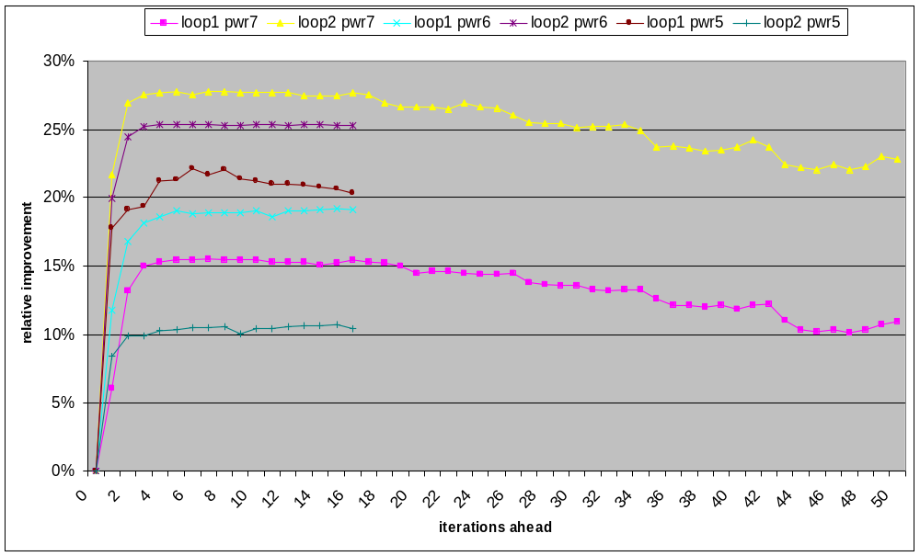
Improvement by prefeching distance

Slide 23
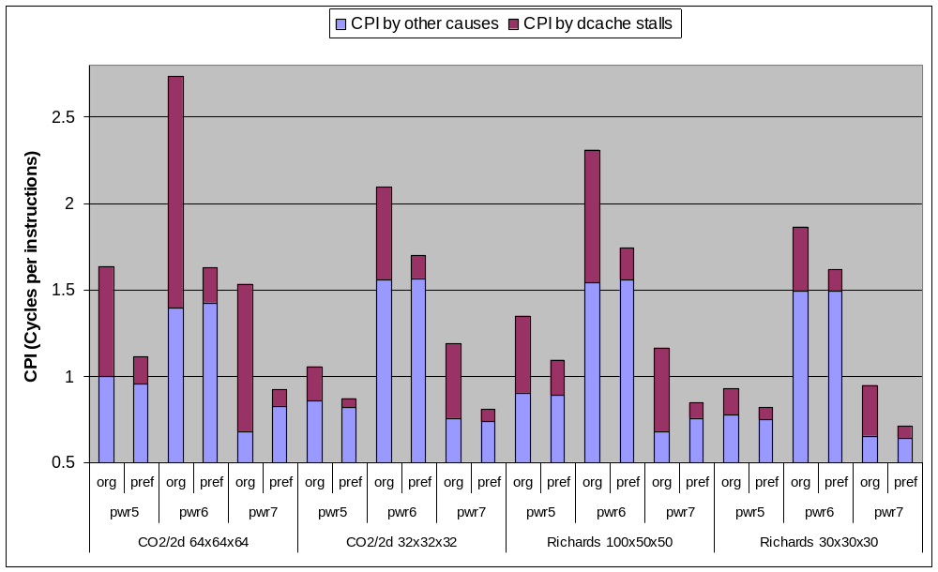
Results

Slide 24
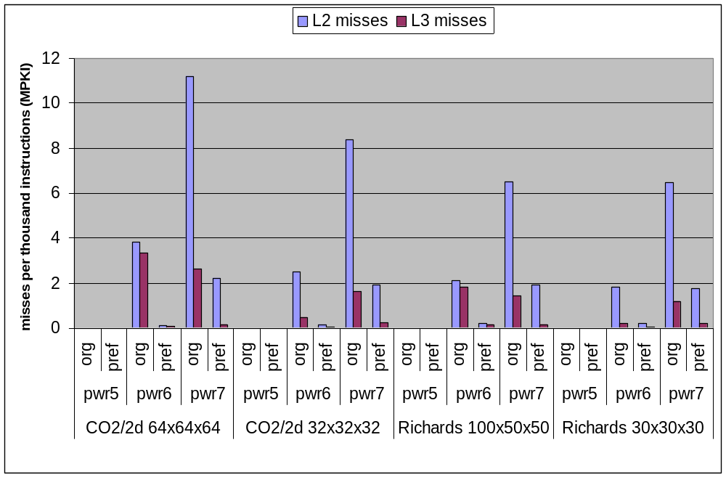
Results

Slide 25
Open Challenges
The PFLOTRAN app maps very well to delinquent load optimization through dynamic compilation
  Interesting code resides in a general purpose library (PETSc)
  Hardware prefetching cannot detect streams
  Prefecthing depends on input
  Cache access characteristics are stable once indentified
Delinquent load optimization is one example where hardware features guiding a compiler improve programmer productivity
Many open questions remain:
  Security
    CPO agent, JIT and user app reside in same address space
  Debugging
  Testarossa can compile static languages (C, C++, Fotran) but still has a Java flavor and lacks important optimizations (better register allocator, better notion of arrays, loop transformations, vectorization, …)
  We can compile parallel languages like UPC and OpenMP but TPO replaced all parallel semantics with function calls
  Hardware events APIs still designed for off-line analysis rather than online operations
  Exchange of information between static and dynamic compilation phases (“FatFile”)
    XCoff and ELF define containers (sections) but there is no standard of how to store and reuse compilation information

